Slide 1
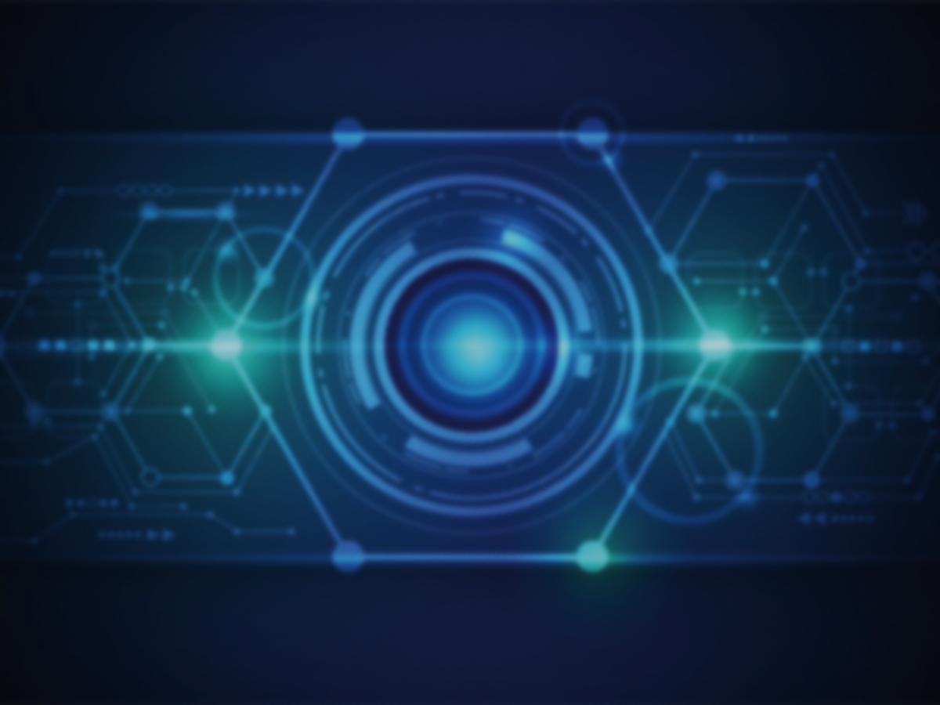
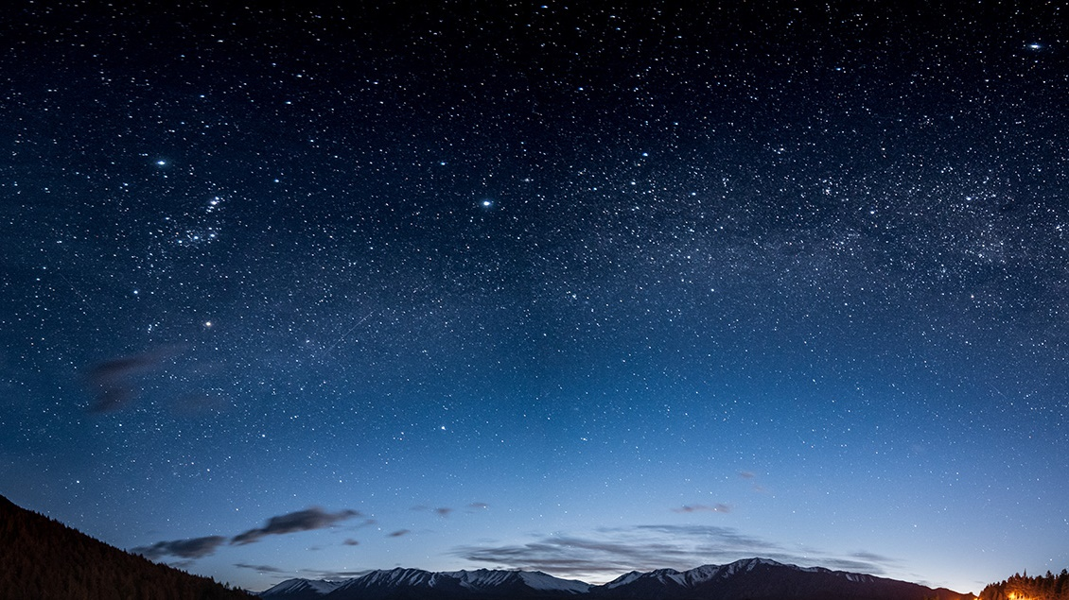
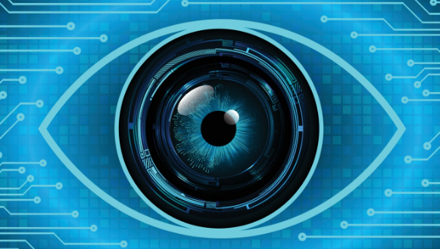
IMAGE PROCESSING ASSISTANT

Slide 2

Department of Computer Applications
GALGOTIAS COLLEGE OF ENGINEERING AND TECHNOLOGY
A
Presentation on
“IMAGE PROCESSING ASSISTANT”
MCA III Semester (Session: 2022-23)
Submitted By:
Anurag Singh 2100970140014
Dhruv Singh 2100970140020
Abhilakh Singh 2100970140002
Submitted to:
Mr. Sanjaya Tripathi

Slide 3
CONTENT
INTRODUCTION
NEED & GOALS
ABOUT IMAGE PROCESSING
SYSTEM FEATURES
LIBRARIES
HARDWARE & SOFTWARE

Slide 4
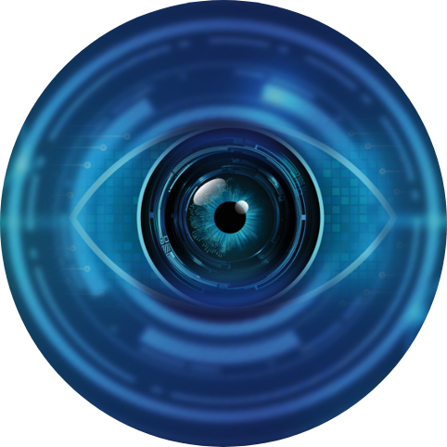
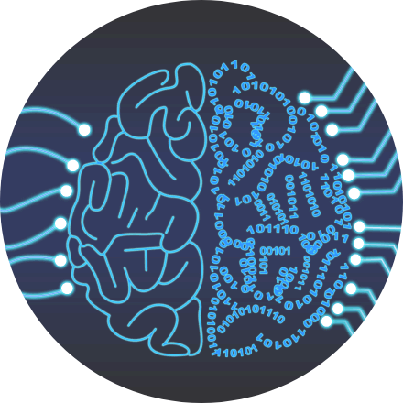
Technology USED
Image Processing
Voice Recognition
Artificial Intelligence
Smart Product

Slide 5
2. NEED And Goals
In this modern world we do a lot of things with image and sometimes out confidential data get leaked on various fraud sites containing malwares in it.
In the age of the internet and social media, images have become an important part of how we communicate and share information. However, with the ease of sharing comes the risk of confidential data getting leaked.
This can happen through various means such as hacking, malware, or simply by mistake.
One common way that confidential data gets leaked through images is through metadata. Metadata is essentially data about the data in an image file, including information about the camera, date and time the photo was taken, and even the GPS location.
So main Goal is to protect against confidential data leakage, it is important to remove metadata from image files, use secure file-sharing services, and avoid downloading or opening images from unknown or suspicious sources.
This Image Processing software works offline and does not store photo in any database.

Slide 6
3. ABOUT IMAGE PROCESSING
As the name says, image processing means processing the image and this may include many different techniques until we reach our goal.
The final output can be either in the form of an image or a corresponding feature of that image. This can be used for further analysis and decision making.
An image is a 2D representation of a picture or scene. It is made up of small dots called pixels, which contain information about the color and brightness of that part of the image. A digital image is an image that is stored as a set of numbers in a computer, where each number represents the intensity of a pixel. An RGB image is a type of digital image that uses three color channels (red, green, and blue) to create a full-color image.
RGB image: It contains three layers of 2D image, these layers are Red, Green, and Blue channels

Slide 7
4. SYSTEM FEATURES
Welcome Screen
Image To Text
Image To Sketch
Text To Handwriting
Gesture Mouse
Gesture Control
QR Reader

Slide 8
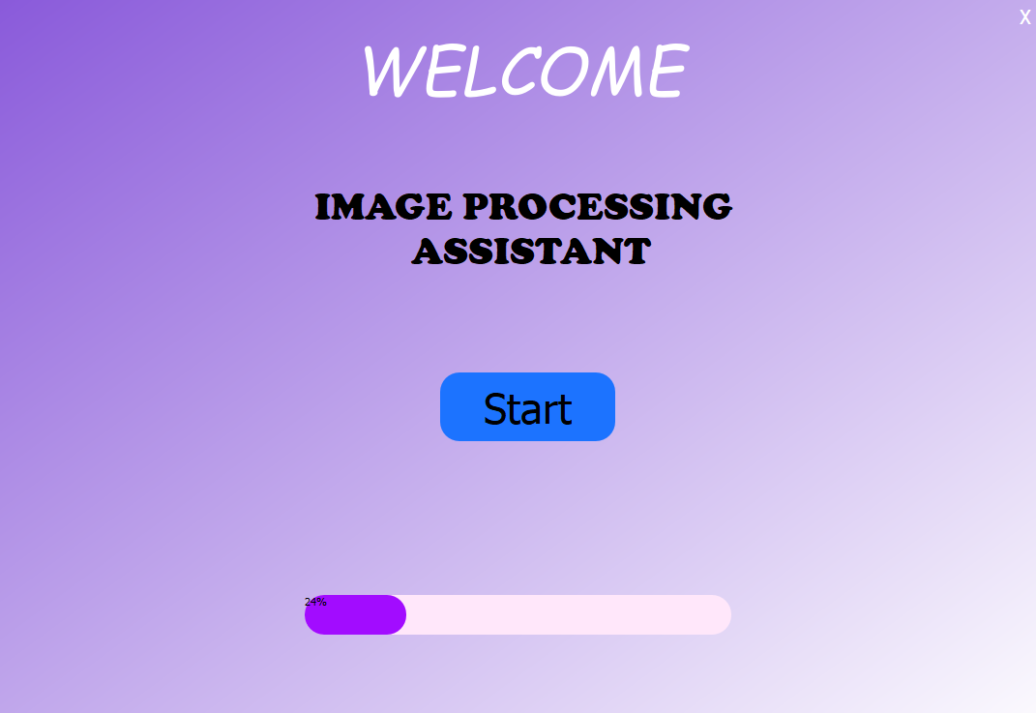

Slide 9
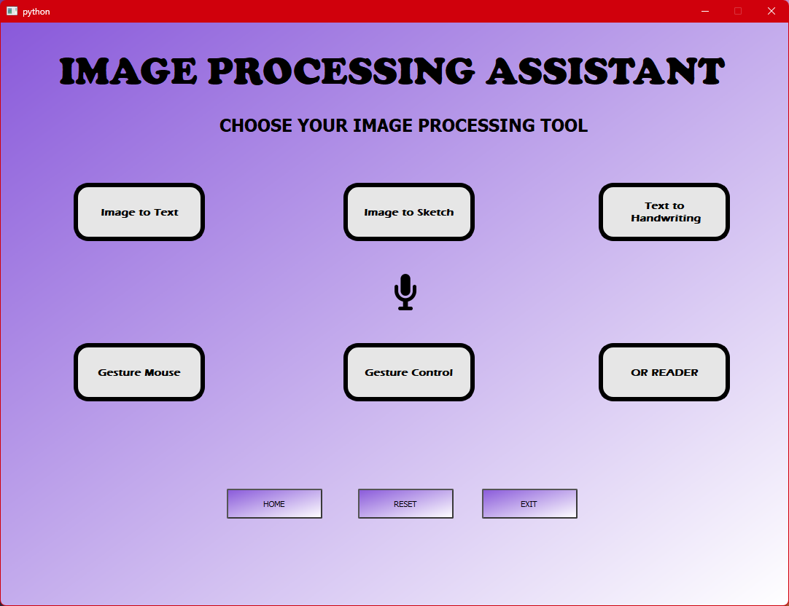

Slide 10
SYSTEM FEATURES
Image To Text:
It will convert the text in image to actual Text into an .txt file
This Function will convert the content in image into text format so user can copy and pasty and use anywhere he/she wants these days we do a lot of work related to image so this function might be very useful out of our other function
User have to select image or enter path.
Image To Sketch:
It will convert image to sketch
Sometimes we have to instantly convert the image to an sketch so we can actually copy and create of our own so without going to million of fake sites to convert the image this tool can be useful .

Slide 11
SYSTEM FEATURES
Text To Handwriting:
It will convert the entered text into Handwritten notes in the form of images and PDFs
We stuck in a lot of situations where we have to write something huge and printout physically but this tool can be useful try it.
User have to enter some text or paste it or anything then hit convert it will convert and save image format in default folder and will open pdf of those images so you can printout .
Gesture Control:
Using this function user can control volume using their fingers.
Additional customizable gestures are available like play pause music, etc.

Slide 12
SYSTEM FEATURES
QR Reader:
QR reader will scan and read the QR code in the camera.
This function works on OpenCV so camera will open and user have to show any bar code / QR Code it will show the data in it. An save it in text format.
Mouse Gesture (Beta):
Control mouse pointer with your finger .
This function is still under working but user can be able to control mouse pointer using their finger and hand gesture.

Slide 13
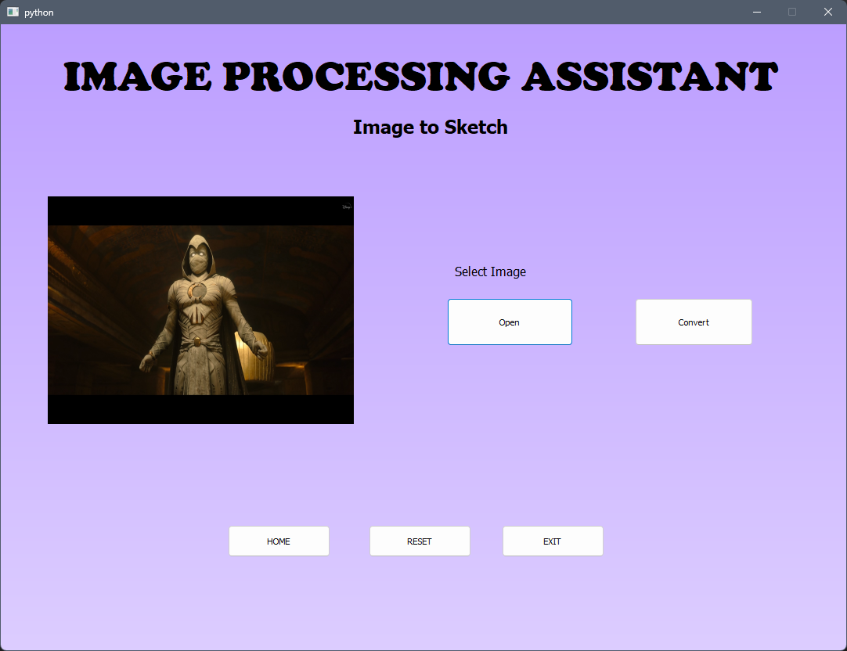
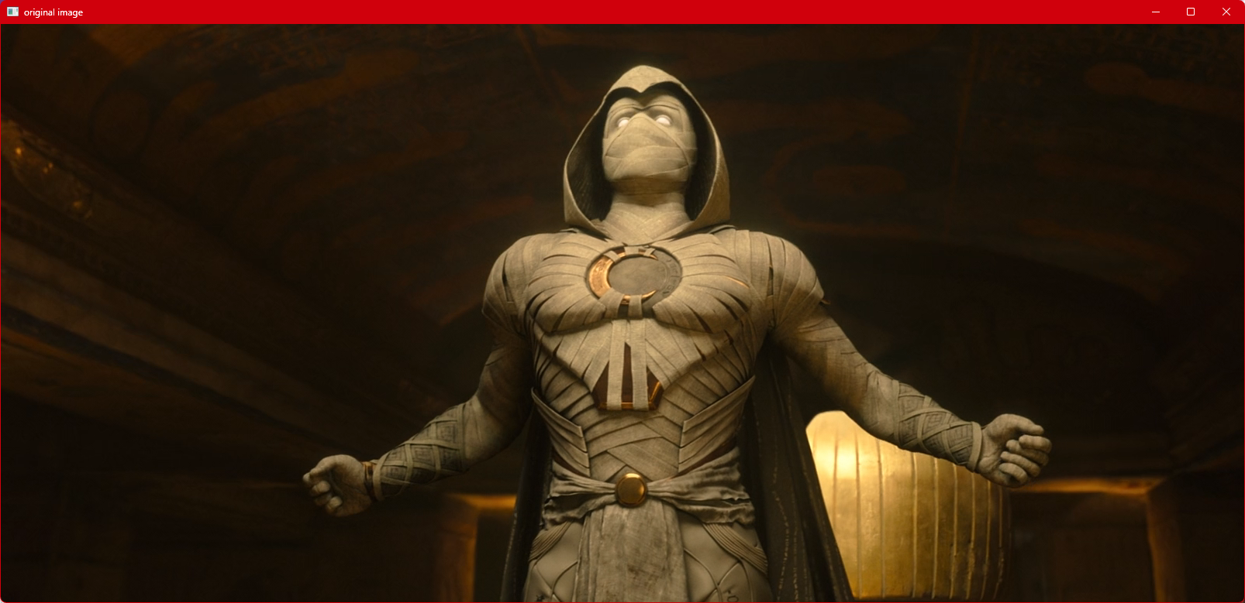
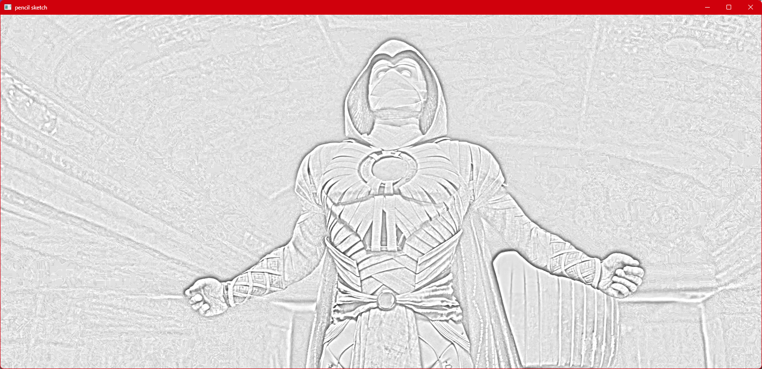
Image to Sketch

Slide 15
Image to Sketch

Slide 16
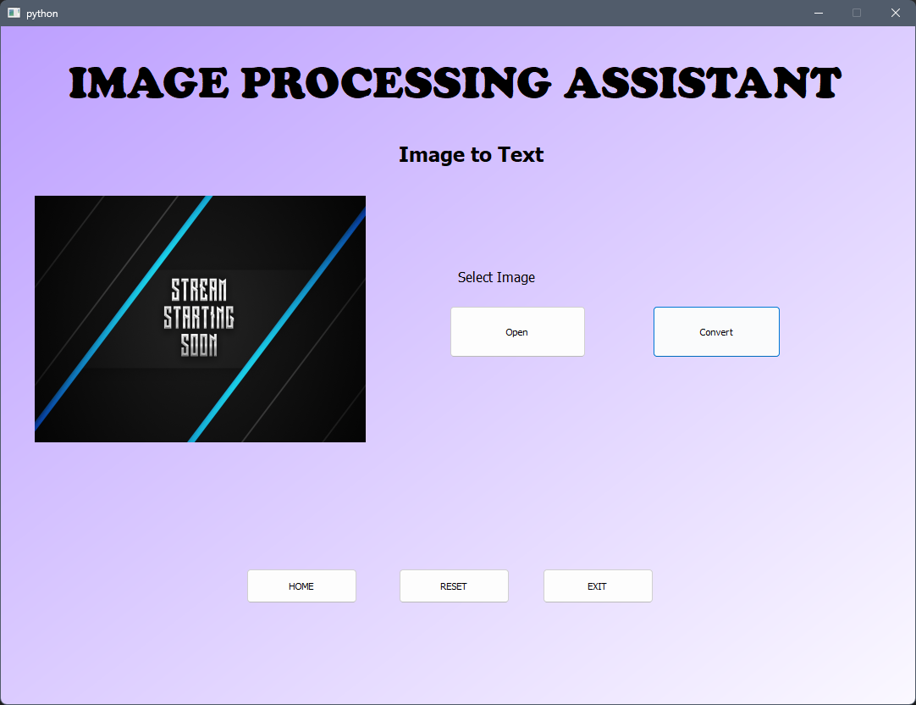
Image To text

Slide 17
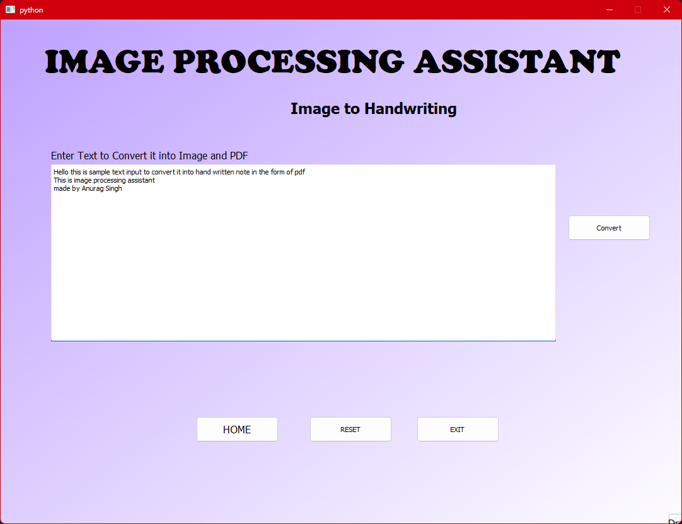
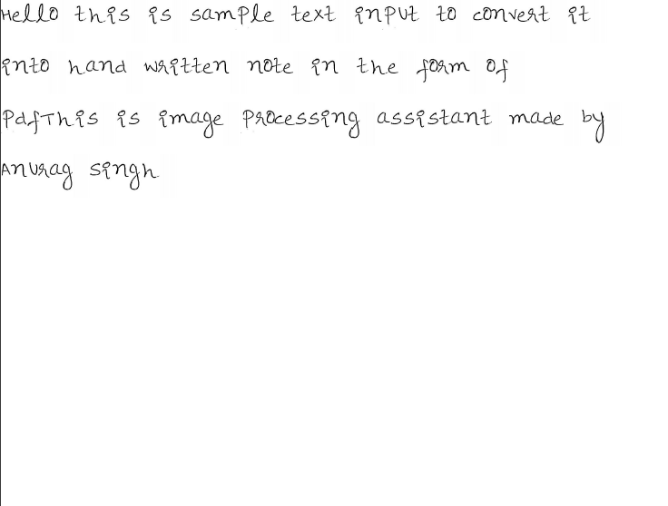
Text To Handwriting

Slide 18
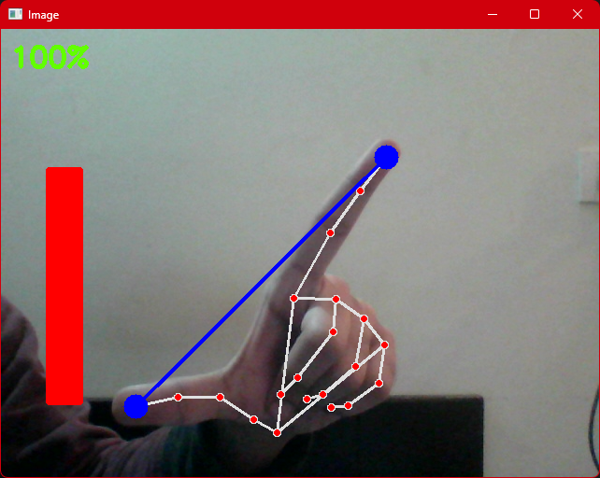
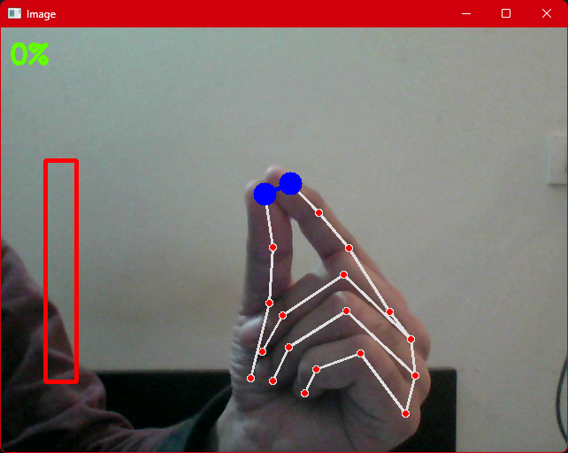
Gesture Control

Slide 19
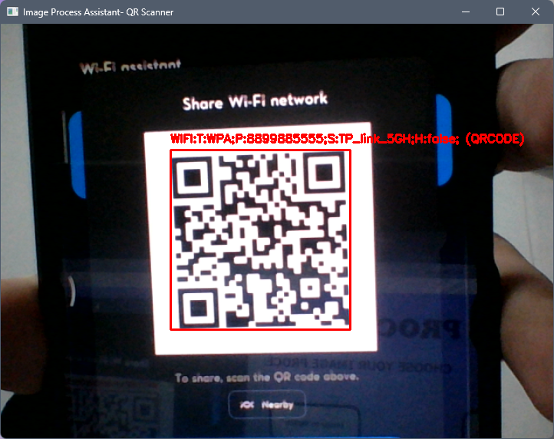
QR Reader

Slide 20
5. LIBRARIES
OpenCV:
OpenCV (Open Source Computer Vision Library) is one of the most widely used libraries for computer vision applications. OpenCV-Python is the Python API for OpenCV.
Converting images from one color space to another i.e. like between BGR and HSV, BGR and gray etc.
Smoothing of images, like, applying custom filters to images and blurring of images.
Scikit-image:
It makes use of machine learning with built-in functions and can perform complex operations on images with just a few functions. It works with numpy arrays and is a fairly simple library
To implement gaussian smoothing use gaussian() method in the filters module.
To rotate the image use rotate() function under the transform module.
To rescale the image use rescale() function from the transform module.

Slide 21
5. LIBRARIES
PIL/pillow:
PIL stands for Python Image Library and Pillow is the friendly PIL fork by Alex Clark and
It supports a wide range of image formats like PPM, JPEG, TIFF, GIF, PNG, and BMP.
It can help you perform several operations on images like rotating, resizing, cropping, grayscaling etc.
NumPy:
With this library you can also perform simple image techniques, such as flipping images, extracting features, and analyzing them.
Images can be represented by numpy multi-dimensional arrays and so their type is NdArrays. A color image is a numpy array with 3 dimensionsTo rotate the image use rotate() function under the transform module.
To rescale the image use rescale() function from the transform module.

Slide 22
5. LIBRARIES
PyQt:
PyQt is the most important library in this program because of GUI interface and easy use.
PyQt is a Python binding of the cross-platform GUI toolkit Qt, implemented as a Python plug-in.
PyQt connects the Qt C++ cross-platform framework with the Python language, it is a GUI module.
Qt is more than a GUI toolkit

Slide 23

Thank You!

